Slide 1
Clean Big Apple
Investor Opportunity

Slide 2
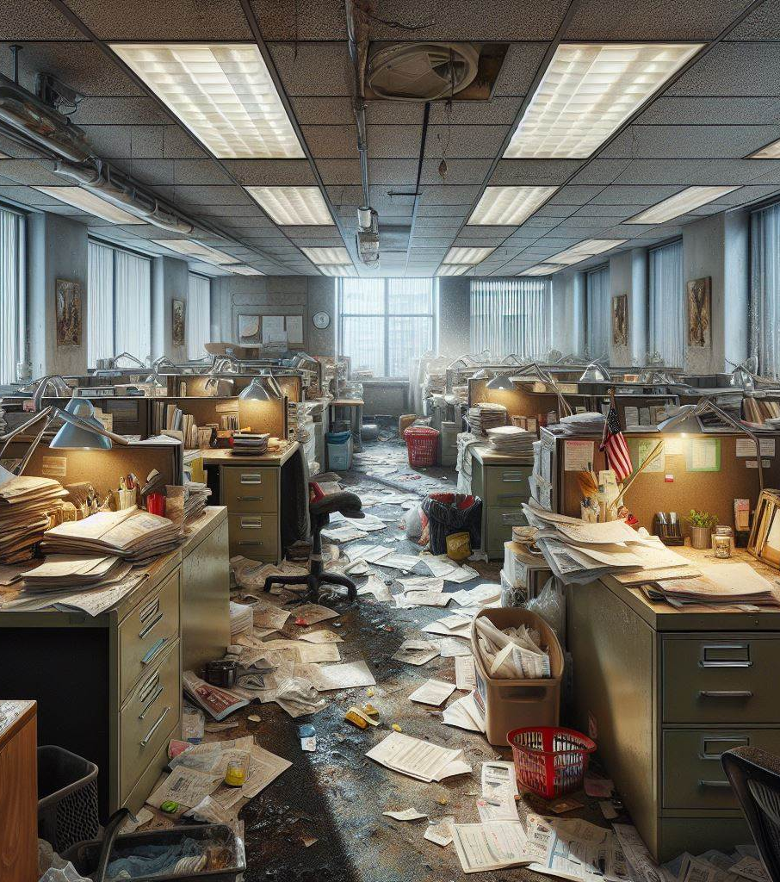

Benefits of Hiring a Commercial Cleaner
Before
Professional Expertise: Corporate cleaning companies have trained professionals who understand the best practices for maintaining a clean and hygienic workspace.
Consistent Cleaning: Regular cleaning schedules ensure that your office remains consistently clean, promoting a healthier environment for employees and visitors.
Time and Cost Savings: Outsourcing cleaning services allows your staff to focus on core business tasks, while the cleaning company handles maintenance. It can also be cost-effective compared to hiring in-house janitorial staff.
Quality Supplies and Equipment: Corporate cleaners use high-quality cleaning products and equipment, ensuring thorough and efficient cleaning.
Positive Image: A clean and well-maintained office reflects positively on your business, impressing clients, partners, and potential employees.
Remember, a tidy workspace contributes to productivity and overall well-being!
After

